Slide 1

Disaster Response and Recovery
Presenter Names:
K.K.Charan Reddy- VU21CSEN0101778
J.Surya - VU21CSEN0100483
Rahul Chaudhary - VU21CSEN0101720
M.Pavan – VU21CSEN0101069
Guide Name:
Dr.S.S.Nandini
CSE, GST, Visakhapatnam

Slide 2
Contents
1.Abstract
2.Introduction
3.Literature Review
4.Requirement Analysis
5.Design Analysis
6.Methodology/ Tools/Methods to be used
7.Implementation
8.Screenshots of the project
9.Results & Discussions
10.Conclusion and Future Scope
11.References
CSE, GST, Visakhapatnam

Slide 3
ABSTRACT
Earthquake prediction is a critical area of research in disaster management, which aims at reducing the devastative impacts of earthquakes by providing forecasts in time. This project makes use of the advanced machine learning models and seismic data analysis to predict the occurrence of earthquakes with increased accuracy. This study identifies the patterns from the historical seismic data, including features like magnitude, depth, and location, to aid in probabilistic forecasting. This approach gives them value insights into early warnings, resource allocation, and enhancement of community preparedness for eventual resilience against disasters related to earthquakes.

Slide 4
INTORDUCTION
Earthquakes are one of the most damaging natural disasters resulting in severe casualties and damage but are hard to predict due to their complexity. This project thus attempts to make a new hybrid approach using seismic data to identify patterns. We will leverage advanced machine learning models, such as Decision Trees, Random Forest, LightBGM, XGBoost etc to enhance the accuracy of predictions and develop a reliable framework for disaster response and recovery. The work is on enabling early warning systems and optimizing resource planning to mitigate the impact of earthquakes.

Slide 5
LITERATURE REVIEW

Slide 6
TITLE | MAIN POINT
Improving earthquake prediction accuracy in Los Angeles with machine learning - Cemil Emre Yavas, Lei Chen, Christopher Kadlec and Yiming Ji | Researchers Yavas, Chen, Kadlec, and Ji used sophisticated machine learning methods, specifically the Random Forest algorithm, to forecast peak earthquake magnitudes in Los Angeles over a 30-day time frame. Their model had an impressive accuracy of 97.97%, greatly improving seismic risk management and preparedness planning.
Earthquake magnitude prediction in Hindukush region using machine learning techniques - K. M. Asim, F. Martinez-A lvarez, A. Basit, T. Iqbal | The research delves into machine learning methods for earthquake magnitude prediction in the Hindukush area. Based on seismic data from the past, the authors implement different models to find patterns and enhance forecast accuracy. The research points towards the capability of AI-based methodologies for early warning systems to support preparedness for disasters & reducing risks.
Major earthquake event prediction using various machine learning algorithms - Roxane Mallouhy, Chady Abou Jaoude, Christophe Guyeux, Abdallah Makhoul | The research paper "Major earthquake event prediction using different machine learning algorithms" by Roxane Mallouhy, Chady Abou Jaoude, Christophe Guyeux, and Abdallah Makhoul examines the performance of eight machine learning algorithms for the task of categorizing seismic events into major and minor earthquakes. The work assesses each of the models in terms of a number of metrics to conclude that Random Forest and K-Nearest Neighbors are the most precise classifiers.
Earthquake magnitude prediction in Turkey: a comparative study of deep learning methods, Earthquake response and recovery ARIMA and singular spectrum analysis - Hatice ¨ Oncel C¸ekim1, Hatice Nur Karakavak1, Gamze ¨ Ozel1, Senem Tekin2 | This research compares deep learning approaches used in forecasting earthquake magnitudes in Turkey. It combines ARIMA and SSA for earthquake response and recovery modeling. The study analyzes forecasting precision, stating the superiority of hybrid models in the depiction of seismic patterns and enhancing disaster preparedness and mitigation measures.
Big data analytics in prevention, preparedness response and recovery in crisis and disaster management - D Emmanouil, D Nikolaos | Big Data is crucial for crisis management, as it helps manage vast information , improving decision-making during crises through data analytics and visualization. The Big Data management process involves four phases: data generation, acquisition, storage, and analytics, ensuring structured data handling for effective analysis.

Slide 7
REQUIREMENT ANALYSIS

Slide 8
DATA COLLECTION
Collection of seismic data from the trusted sources such as USGS or local geological departments.
Types of Data: Magnitude, location, time of earthquakes and other environmental variables.
Tools: APIs, such as the USGS Earthquake API, web scraping, and cloud storage solutions like AWS or Google Cloud.
30 lakhs entries throughout the world were collected from iris website.
The SAGA Earthquake website provides real-time seismic data, educational resources, and research tools for studying earthquake activity worldwide.

Slide 9
RISK ASSESMENTS AND ALERTS
Identification of forecasted earthquake magnitude, place, and hour to identify associated risks.
Categorization of different areas by different levels of risks to provide immediate response.
Automation of an alert system that provides alerts to governments, first-line responders, and the public at large.
Quick dissemination through mobile alerts, sirens, and public address systems.
Integrate population density and infrastructure susceptibility into the models for more localized alerts.

Slide 10
REPORTING AND VISUALIZATION
Creation of interactive dashboards to display earthquake predictions and risk levels.
Use of geographic information systems (GIS) to map seismic activity and vulnerable areas.
Show metrics of model performance, such as accuracy and false positives, for added transparency.
Real-time display of alerts and predictions to ensure situational awareness during emergencies.

Slide 11
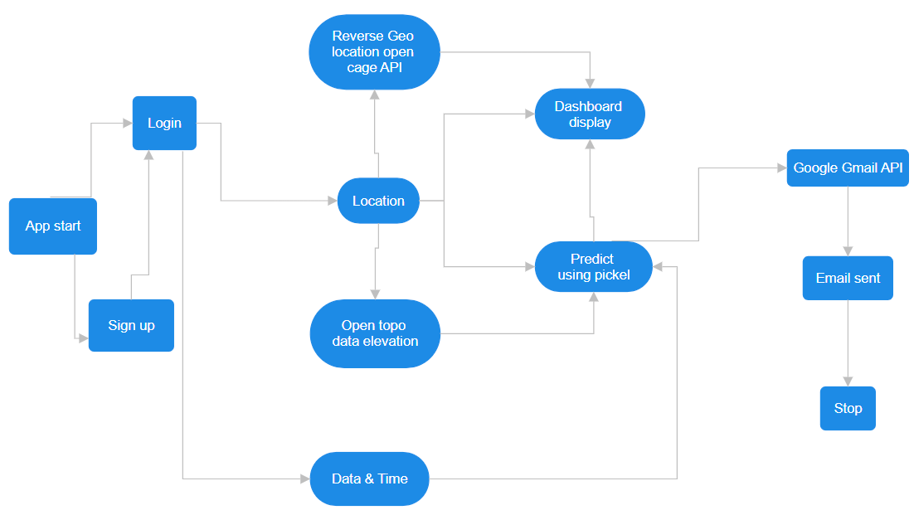
DESIGN ANALYSIS

Slide 12
Methodology/ Tools/Methods to be used

Slide 13
DATA ANALYTIC TOOLS
Python: Primary programming language for data analysis, modelling, and visualization.
Pandas & NumPy: For data manipulation and analysis.
Matplotlib & Seaborn: For visualizing data trends and model performance.
SQL: To manage and query large datasets efficiently.
GIS Software (e.g., QGIS): For mapping seismic and weather data spatially

Slide 14
MACHINE LEARNING FRAMEWORKS
Scikit-learn: For implementing machine learning models like Random Forest, LightGBM and XGBoost.
XGBoost: For advanced Gradient Boost modelling and optimization.
TensorFlow/Keras: For designing and training custom hybrid models.
Hyperopt: For hyperparameter optimization of machine learning models

Slide 15
IMPLEMENTATION

Slide 16
MODEL SELECTION
Random Forest Regressor : The process in which the big data is divided into datasets under multiple decision tress and based on the result of each tree the output will be predicted.
XGBoost : it is an optimize version of gradient boost in which many weak models will be assembled to form a stronger model.
LightGBM : it is an ensemble framework which uses gradient boost to develop a strong learner by adding many weaker learners in a gradient descent manner.
Handling missing or incomplete data using imputation techniques.
Normalizing data to maintain consistency in variables.
Feature engineering is the process of creating meaningful inputs for machine learning models, like seismic frequency trends or atmospheric anomaly indices.
Training models on historical seismic and weather data with an 80-20 train-test split Hyperparameter tuning for each model.
Random Forest: Number of estimators and maximum features.
LightGBM : prioritizes all the features of dataset during prediction.
XGBoost : gives more optimized output.

Slide 17
MODEL EVALUATION
Metrics used:
Accuracy: Correctness of overall predictions.
Precision and Recall: To measure false alarms and missed predictions.
F1-score: The balanced metric to assess the performance.
Cross-validation for robustness and consistency of the model.

Slide 18
SCREENSHOTS OF THE PROJECT

Slide 19
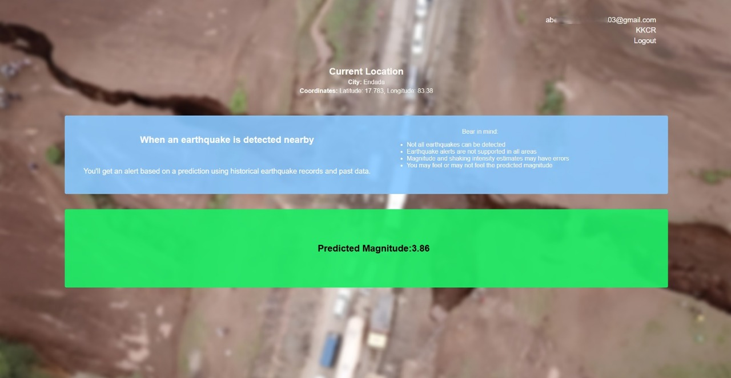
Dashboard :

Slide 20
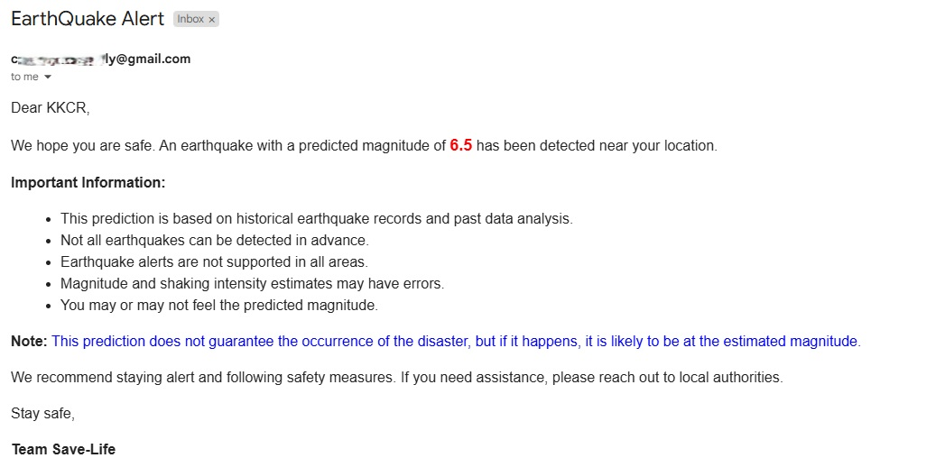
Sample Email Alert :

Slide 21
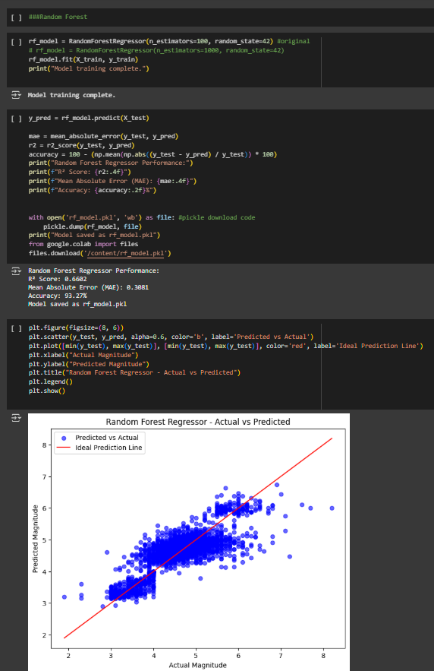
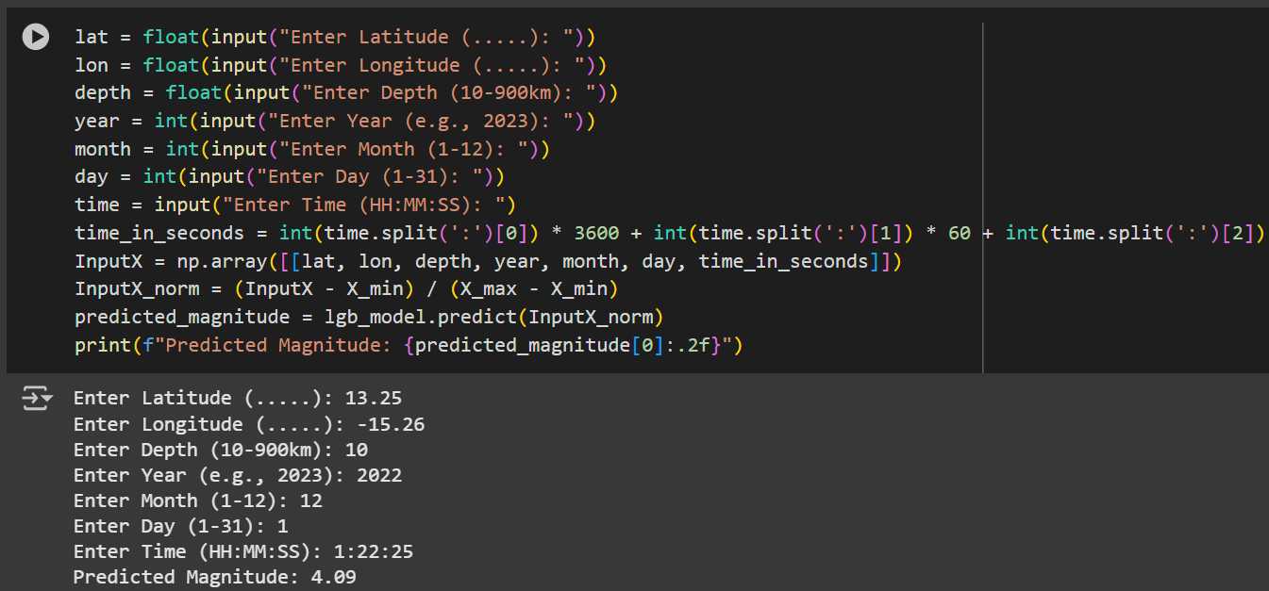
Sample Code :

Slide 22
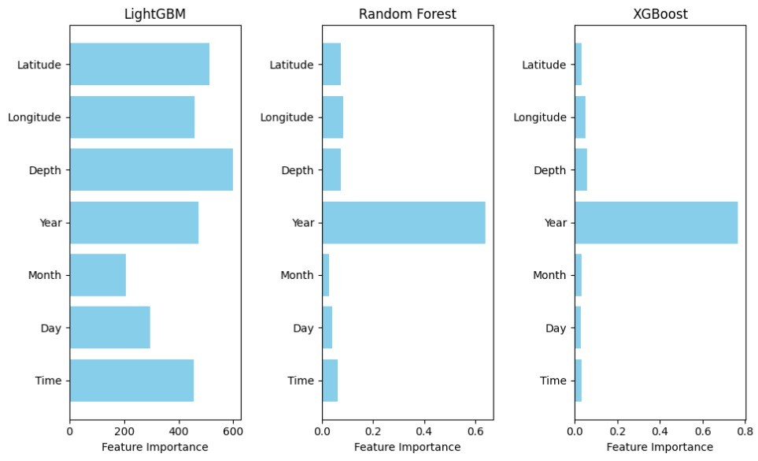
RESULTS & DISCUSSION
MODEL | ACCURACIES
Random Forest Regressor | 93.27
Support Vector Machine | 92.13
Decision Trees Regressor | 90.73
K-Nearest Neighbour | 91.68
XGBoost | 93.03
Light GBM | 93.36
Multi-Layer Perceptron | 92.71
Recurrent Neural Networks | 91.15
LSTM | 90.79
Gated Recurrent Unit | 91.26
Transformer | 86.53

Slide 23
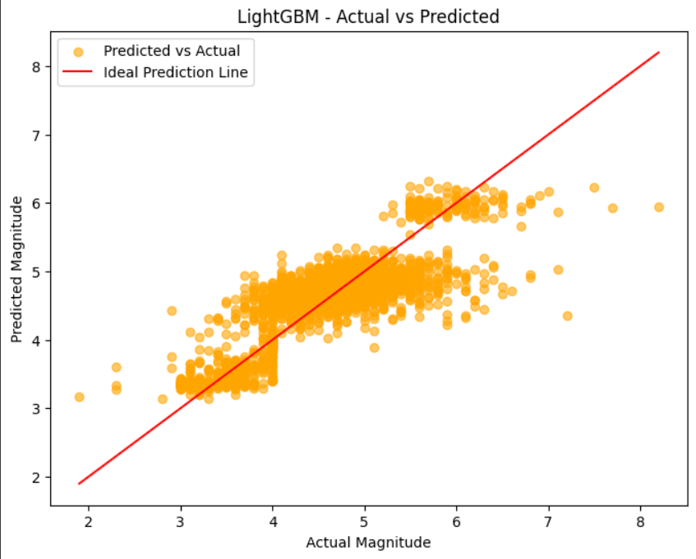
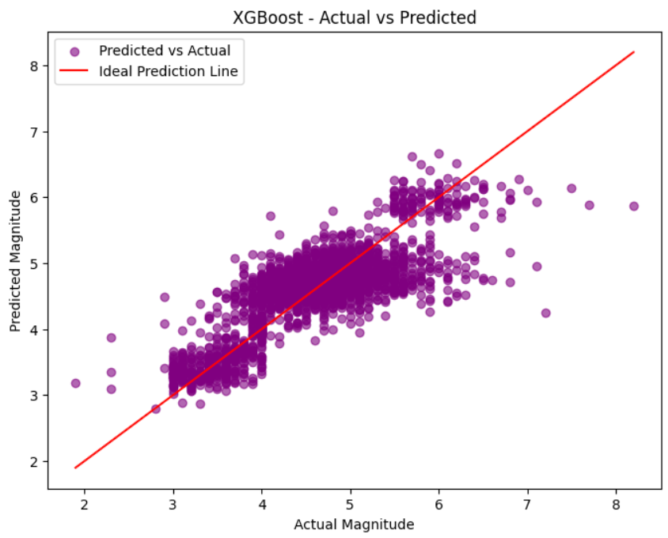

Slide 24
CONCLUSION AND FUTURE SCOPE
The present project is the solution to the challenge of predicting and managing disaster through the advanced machine learning models, including Decision Trees, Random Forest, XGBoost and a Light GBM. All these techniques will improve the precision and reliability of the predictions made, which means an early warning system to the vulnerable communities to mitigate the impact of the natural disasters. Through handling historical and real-time data processing, the system affords critical inputs for decision making, thus enhancing timely responses towards disasters. Further development combined with diverse datasets can provide this solution as an imperative approach for governments and organizations in preventing losses during disasters and building resilience toward catastrophes in the future.

Slide 25
Thank You
CSE, GST, Visakhapatnam

